Slide 2

Applied Algorithm Lab
Gold mining

Slide 3
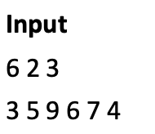
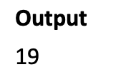
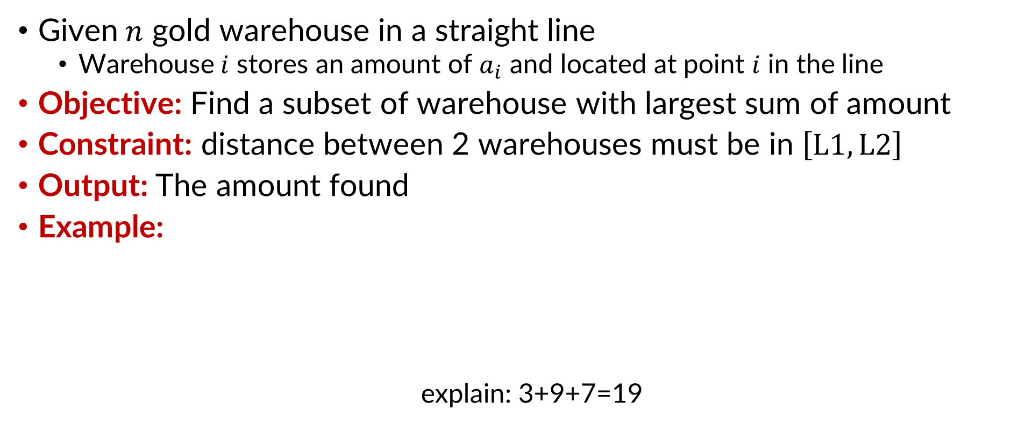
Gold mining
Given$n$ gold warehouse in a straight line
Warehouse$i$ stores an amount of $a_{i}$ and located at point $i$ in the line
Objective: Find a subset of warehouse with largest sum of amount
Constraint: distance between 2 warehouses must be in $\left[L1, L2\right]$
Output: The amount found
Example:
explain: 3+9+7=19

Slide 4
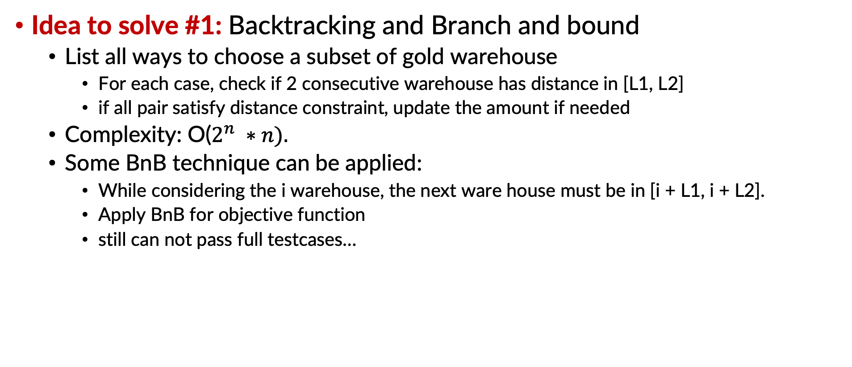
Gold mining
Idea to solve #1: Backtracking and Branch and bound
List all ways to choose a subset of gold warehouse
For each case, check if 2 consecutive warehouse has distance in [L1, L2]
if all pair satisfy distance constraint, update the amount if needed
Complexity: O($2^{n} ∗n).$
Some BnB technique can be applied:
While considering the i warehouse, the next ware house must be in [i + L1, i + L2].
Apply BnB for objective function
still can not pass full testcases…

Slide 5
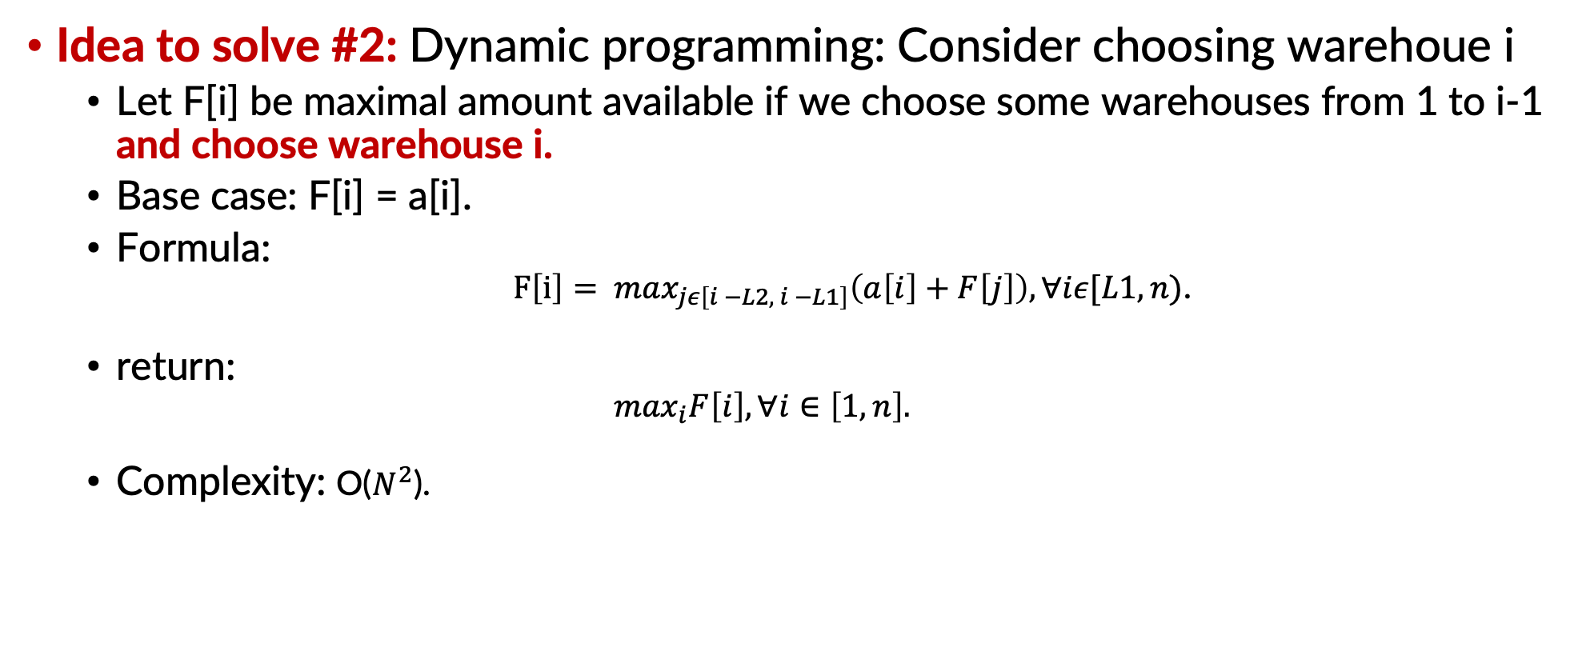
Gold mining
Idea to solve #2: Dynamic programming: Consider choosing warehoue i
Let F[i] be maximal amount available if we choose some warehouses from 1 to i-1 and choose warehouse i.
Base case: F[i] = a[i].
Formula:
$F\left[i\right]= \max_{jε\left[i −L2, i −L1\right]}\left(a\left[i\right]+F\left[j\right]\right), ∀iε[L1, n)$.
return:
$$\max_{i}F\left[i\right], ∀i∈\left[1, n\right].$$
Complexity: O($N^{2}$).

Slide 6
Gold mining
Idea to solve #3: Dynamic programming with priority queue
Priority queue: a queue with order. The element are sorted in order of priority
Improve to idea #2:
An element in priority queue: (j, F[j]) with F[j] be the priority.
element with big F[j] will be in the front
Considering ware house i: add (i – L1, F[i – L1]) to the queue.
Remove the top element of queue if i – i.top > L2.
F[i] = a[i] + F.top.
Complexity: O(n*log(n)).

Slide 7
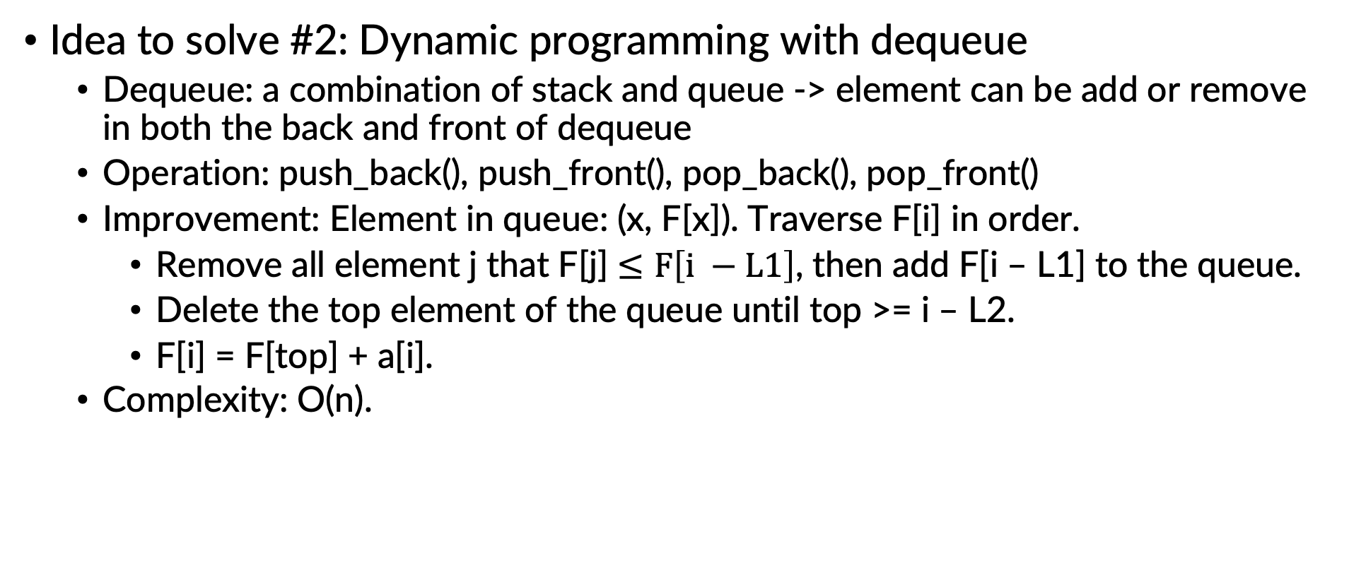
Gold mining
Idea to solve #2: Dynamic programming with dequeue
Dequeue: a combination of stack and queue -> element can be add or remove in both the back and front of dequeue
Operation: push_back(), push_front(), pop_back(), pop_front()
Improvement: Element in queue: (x, F[x]). Traverse F[i] in order.
Remove all element j that F[j] $≤F\left[i −L1\right]$, then add F[i – L1] to the queue.
Delete the top element of the queue until top >= i – L2.
F[i] = F[top] + a[i].
Complexity: O(n).

Slide 8
THANK YOU !

